Slide 1

AASD 4004
Machine Learning - II
Applied AI Solutions Developer Program

Slide 2
Module 1
NLP Revisited
Vejey Gandyer

Slide 3
Agenda
What is NLP
NLP Tasks
Applications
NLP Building Blocks
Challenges of NLP
NLP Approaches
NLP Pipeline

Slide 4
NLP
What is it?

Slide 5
Natural Language Processing (NLP)
Natural language processing (NLP) is a subfield of linguistics, computer science, and artificial intelligence concerned with the interactions between computers and human language, how to program computers to process and analyze large amounts of natural language data.

Slide 6
NLP Tasks

Slide 7
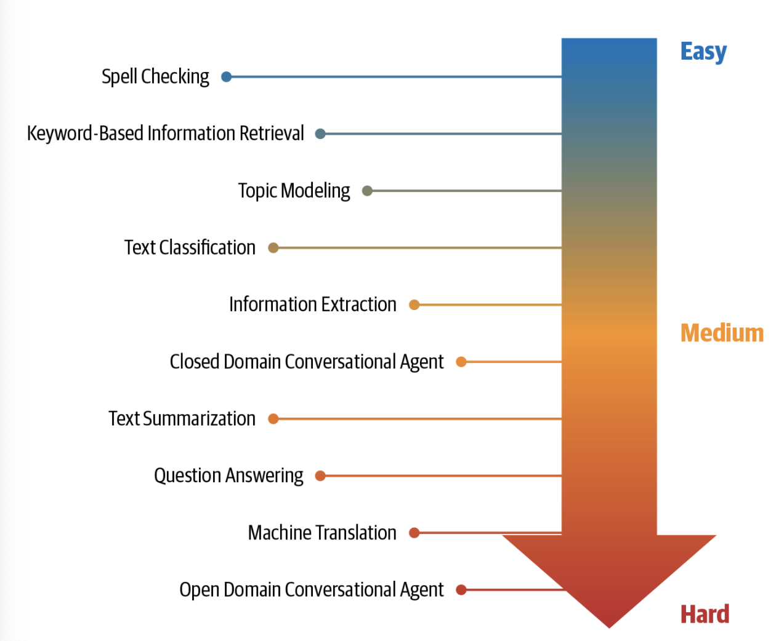
NLP Tasks
Language Modeling
Text Classification
Information Extraction
Topic Modeling
Information Retrieval
Text Summarization
Question Answering
Machine Translation
Conversational Agent

Slide 8
NLP Applications

Slide 9
Text Classification
Predict Tags or Categories
Predict Sentiment
Filter Spam mails

Slide 10
Sequence Applications
Part Of Speech Tags
Named Entity Recognition
Semantic Slots

Slide 11
Sequence to Sequence
Machine Translation
Summarization
Speech Recognition
Question Answering

Slide 12
NLP Building Blocks

Slide 13
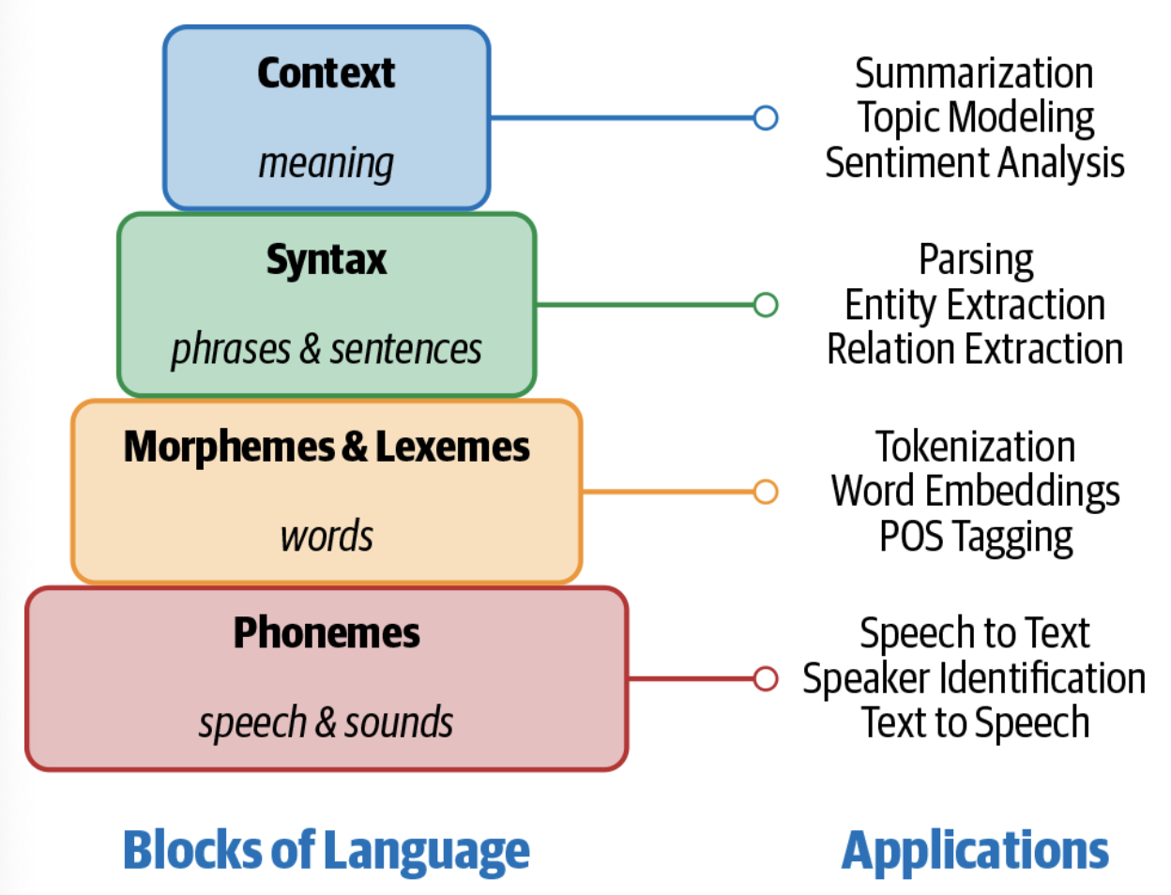
Building Blocks of Language

Slide 14
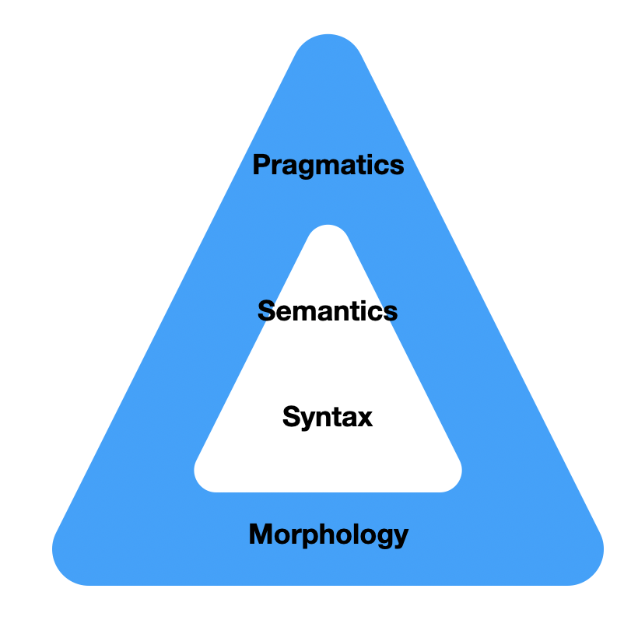
Linguistic Pyramid
Morphology - Pre-processing
Syntax
Semantics
Pragmatics

Slide 15
Representations
Word Embeddings
Sentence Embeddings
Topic Models (Documents)
Vector Space Models
Similarity Graphs

Slide 16
NLP Approaches

Slide 17
NLP Approaches
Rule Based
Regular Expressions
Context-free Grammars
Machine Learning
Probabilistic Modeling
Linear Classifiers
Deep Learning
Recurrent Neural Networks
Convolutional Neural Networks

Slide 18
NLP Pipeline

Slide 19
NLP Pipeline
Evaluation
Monitoring & Model Improvement
Modeling
Deployment
Data acquisition
Text Extraction & Cleaning
Text Pre-processing
Feature engineering
Notes:
Not always its linear like shown here. Going back and forth between steps is fine and essential in real-world

Slide 20
NLP Pipeline
Data Acquisition
Notes:
Data Acquisition – heart of any ML System
Hypothetical NLP project: Creating a NLP system to identify whether the user query is a sales query or a customer care query.
Ideal scenario: Millions of data points available already. No need for data acquisition

Slide 21
Data Acquisition - Motivation
Data Acquisition – heart of any ML System
Hypothetical NLP project: Creating a NLP system to identify whether the user query is a sales query or a customer care query.
Ideal scenario: Millions of data points available already. No need for data acquisition
Real scenario: No data or less data with unlabelled classes. Need to acquire data
But how???

Slide 22
Data Acquisition
Use a Public Dataset
Scrape data from ungated websites
Product Intervention
Data Augmentation
Synonym Replacement
Back Translation
TF-IDF Word Replacement
Bigram Flipping
Replacing entities
Adding noise

Slide 23
NLP Pipeline
Text Extraction & Cleaning

Slide 24
Text Extraction and Cleaning - Motivation
Text Extraction - Process of extracting raw text from input data by removing all the other unwanted non-textual information (markup, metadata, …)
Text Cleaning – a must as real-world data is always messy, noisy and incomplete 99% of the time
Ideal scenario: Cleaned data points already. No need for data cleaning
Real scenario: Noisy, incomplete, messy data. Need to clean data
But how???

Slide 25
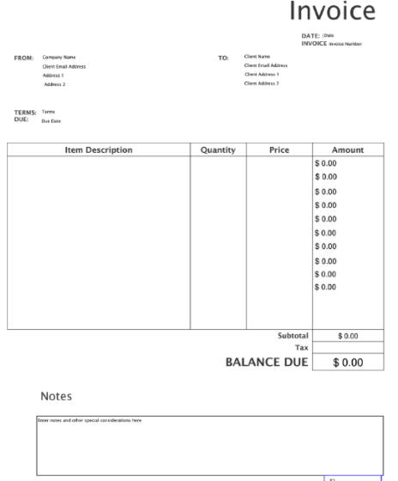
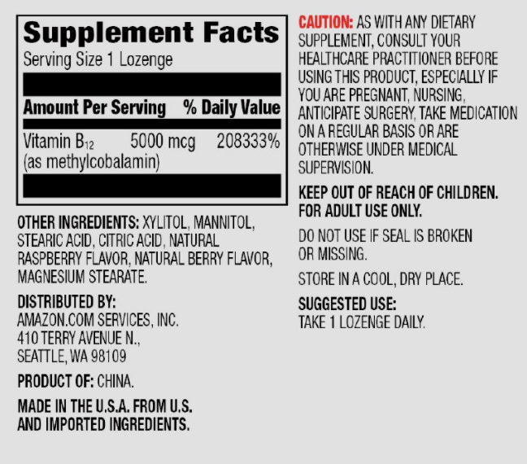
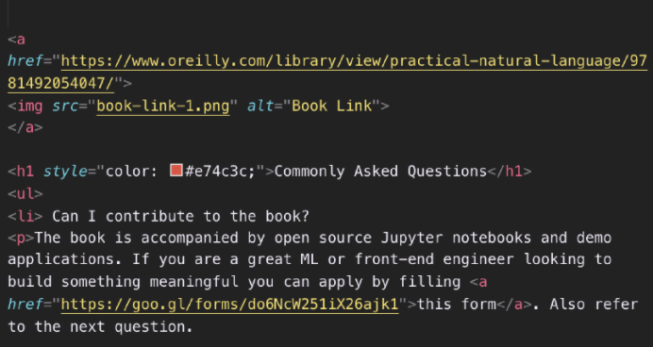
Text Extraction and Cleaning
Various formats of input data (PDF, HTML, continuous stream, …)

Slide 26
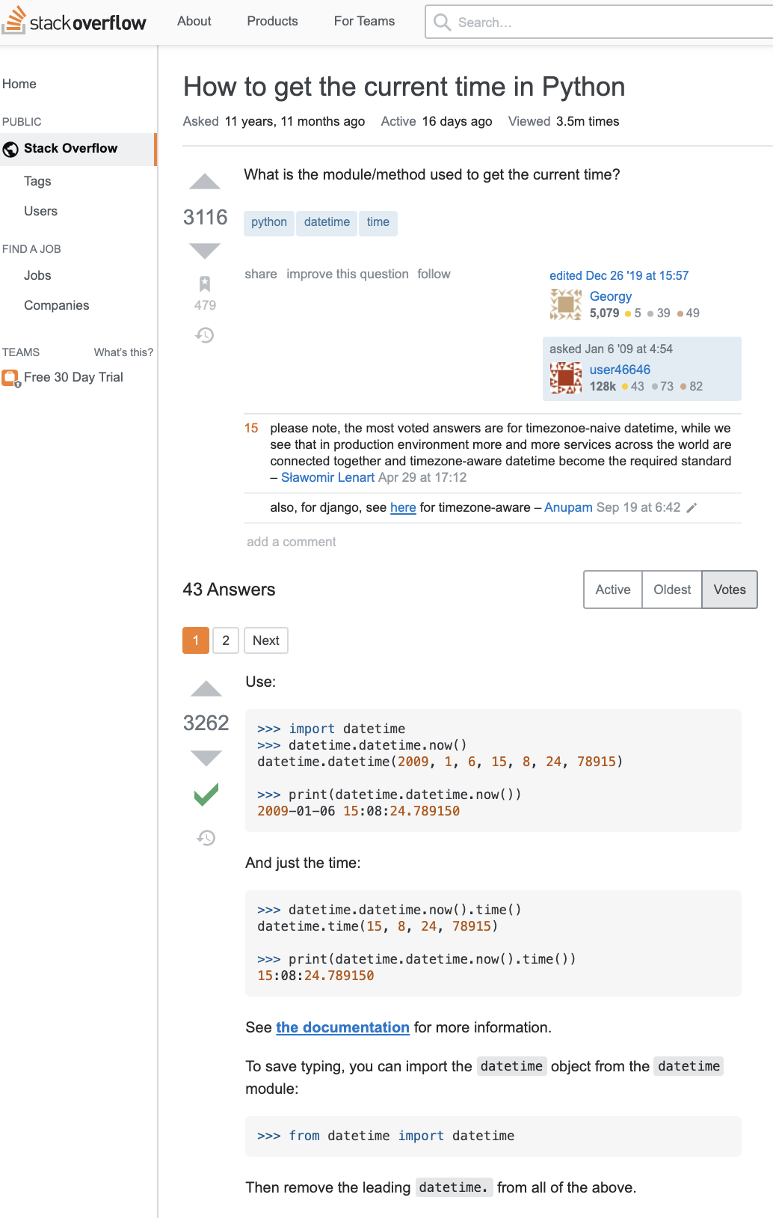
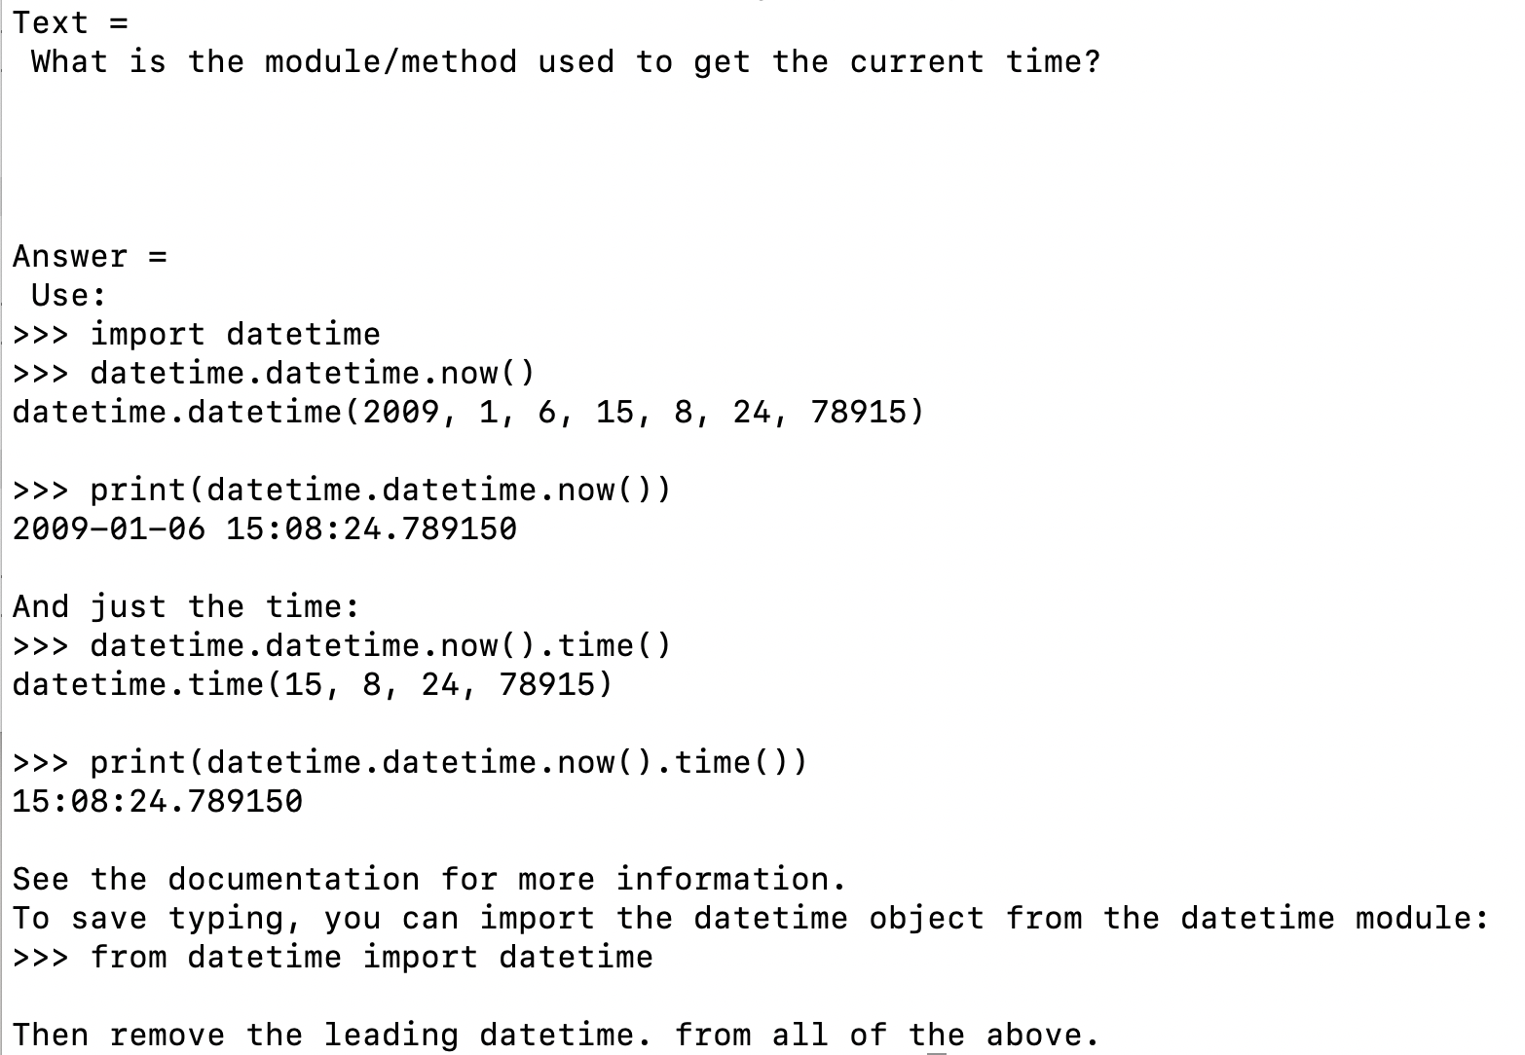
Web scraping
Notes:
https://stackoverflow.com/questions/415511/how-to-get-the-current-time-in-python

Slide 27
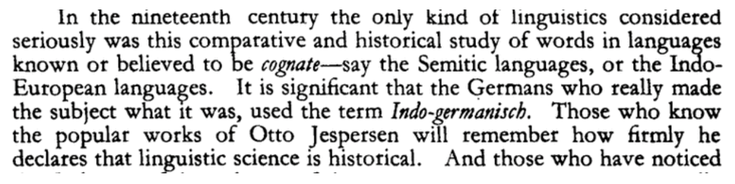
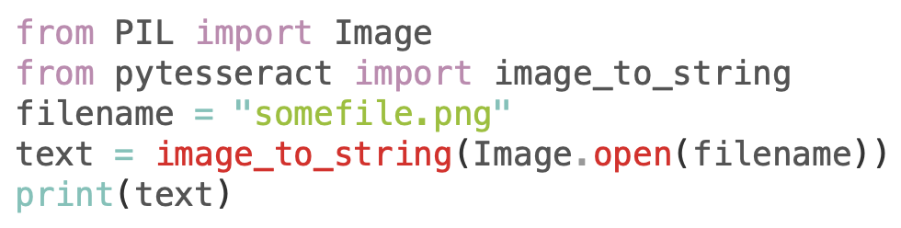
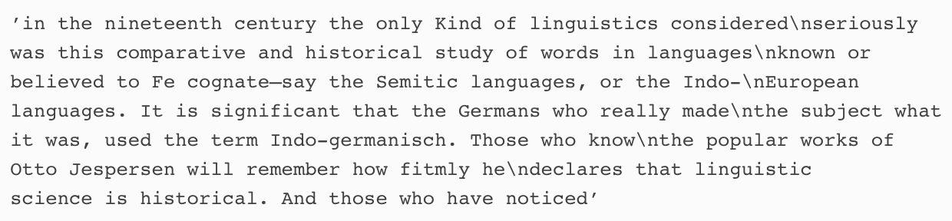
Text extraction from Scanned images
PyPDF, PDFMiner, … can be used to extract PDF text
If PDF text is a scanned image, use Tesseract library
Notes:
https://stackoverflow.com/questions/415511/how-to-get-the-current-time-in-python

Slide 28

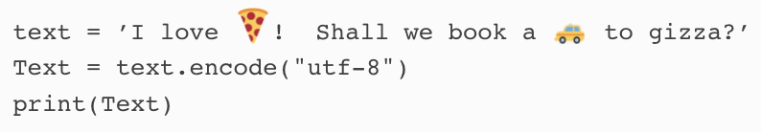
Unicode removal
To remove non-textual symbols and special characters, use Unicode Normalization
Use string.encode("utf-8")
Notes:
https://stackoverflow.com/questions/415511/how-to-get-the-current-time-in-python

Slide 29
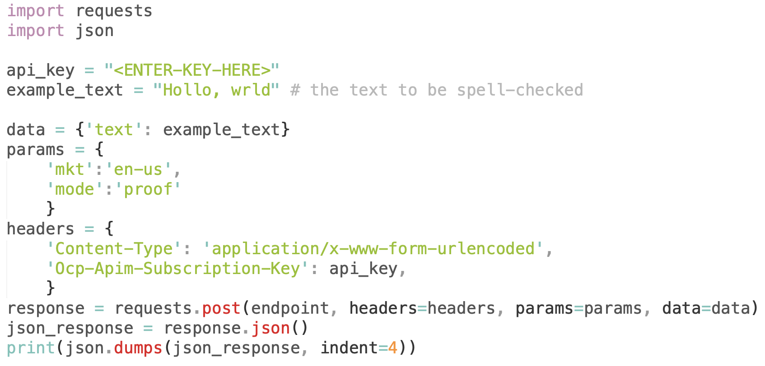
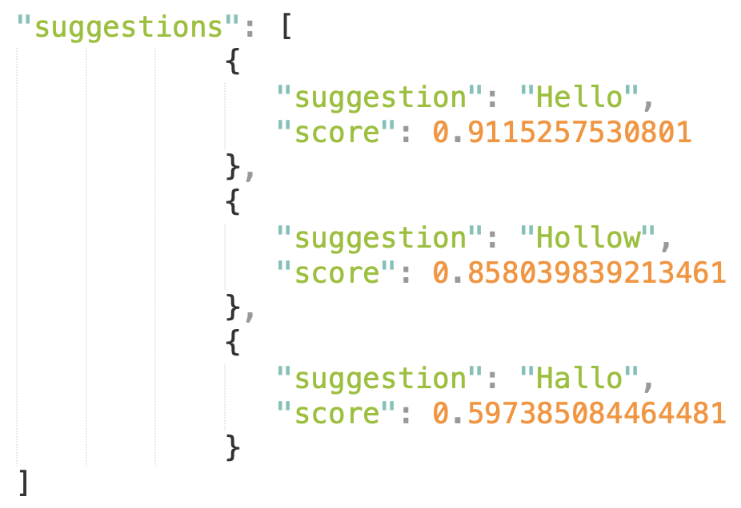
Spelling correction
Microsoft has APIs for spell checking
Use Levenshtein distance for detecting and correcting spelling mistakes
Notes:
https://stackoverflow.com/questions/415511/how-to-get-the-current-time-in-python

Slide 30
NLP Pipeline
Text Pre-processing

Slide 31
Text Pre-processing - Motivation
Text Pre-processing - Process of preparing raw text extracted from data sources by some processes like Sentence Segmentation, Word Tokenization, Stop words, Stemming & Lemmatization, Special characters removal, POS tagging, Coreference resolution, etc.
Text Processing – a must as real-world needs to be in a certain format for a machine learning algorithm to be accepted as input
But how???

Slide 32
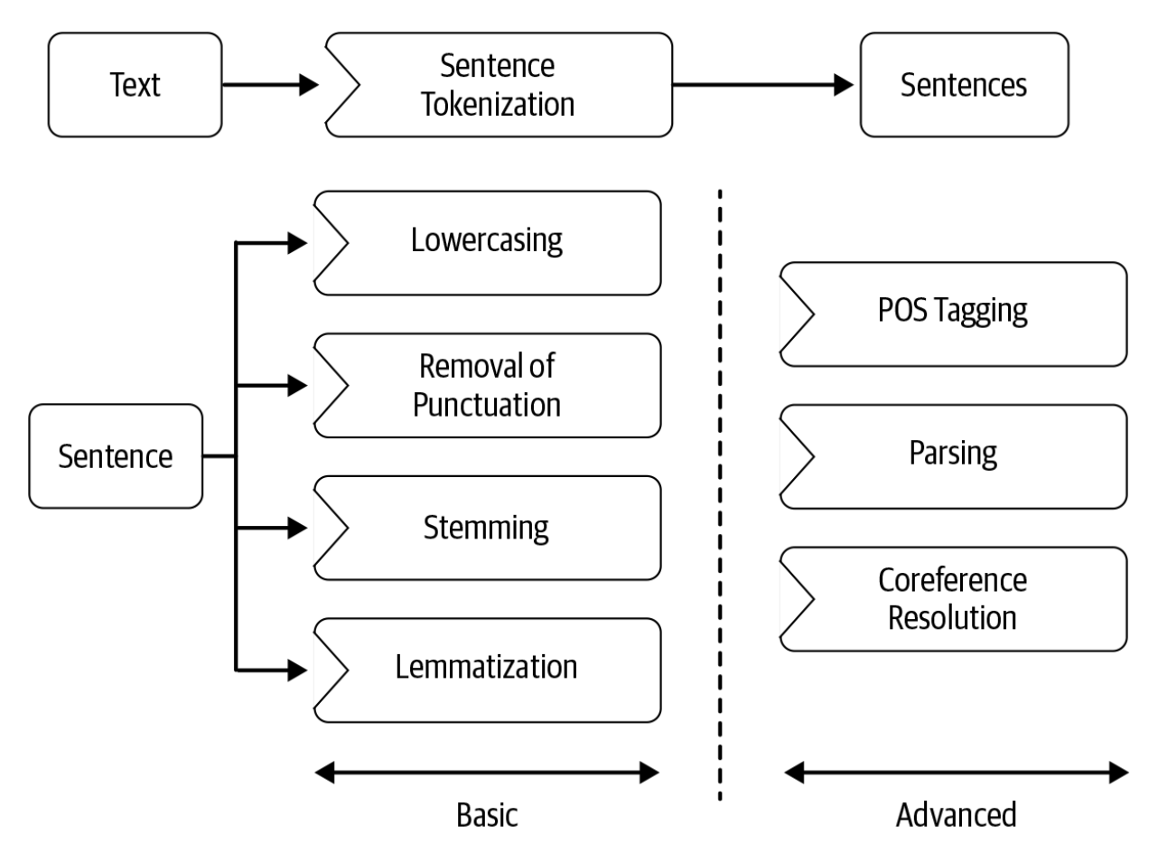
Text Pre-processing
Sentence Segmentation
Word Tokenization
Stop words removal
Stemming & Lemmatization
Normalization
POS tagging
Parse Tree
Coreference resolution

Slide 33
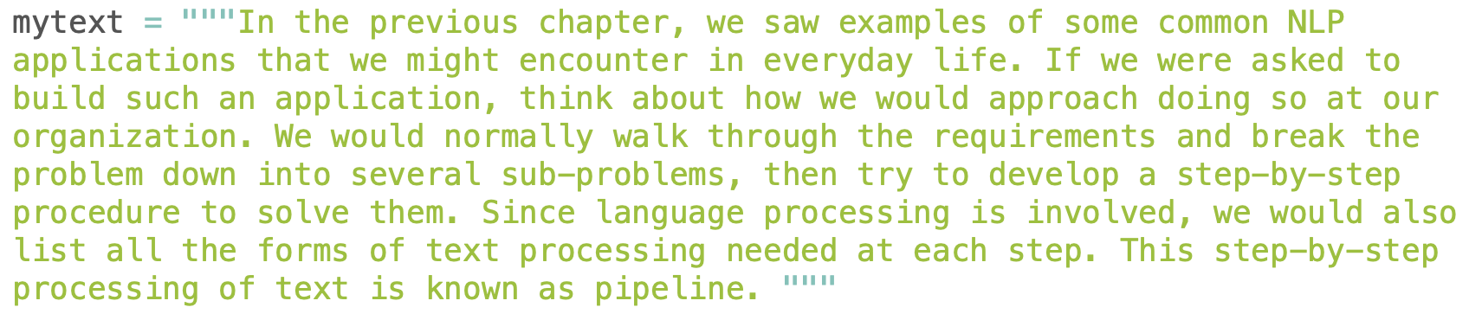
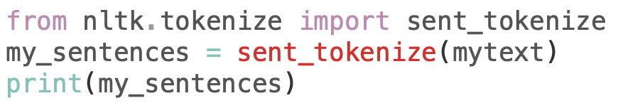
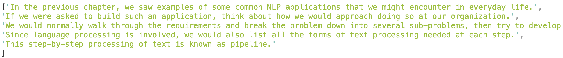
Sentence Segmentation
Breaking a big document text into sentences

Slide 34
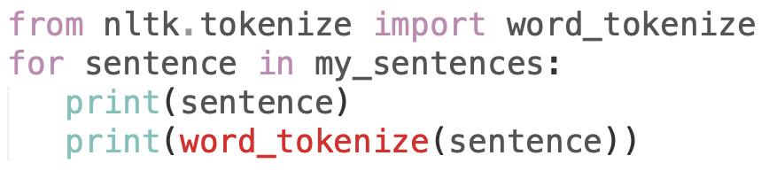
Word Tokenization
Breaking a big sentence into words or tokens

Slide 35
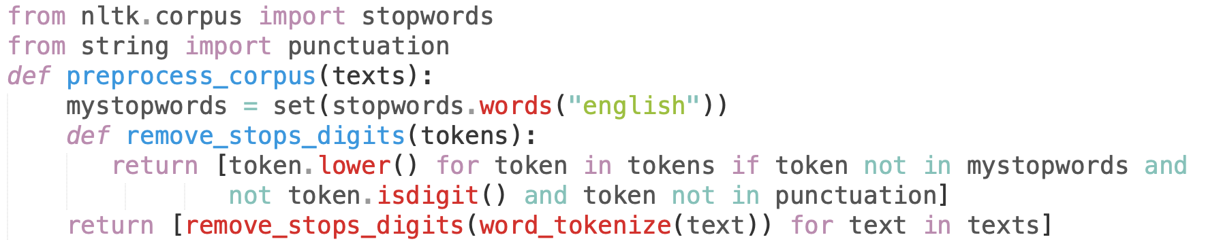
Stop words removal

Slide 36

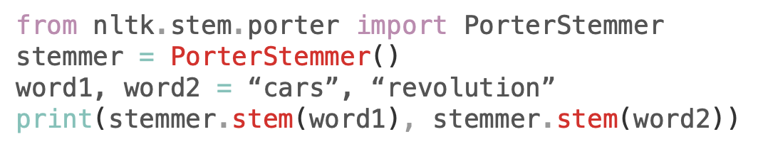
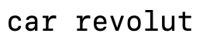
Stemming
Removes suffixes and reduces a word to some base form

Slide 37

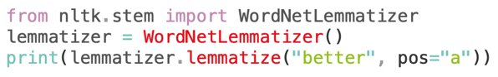
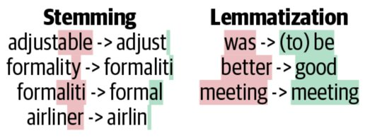
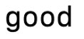
Lemmatization
Also removes suffixes and reduces a word to some base form or lemma
Its lemma will be there in the dictionary (meaningful)

Slide 38
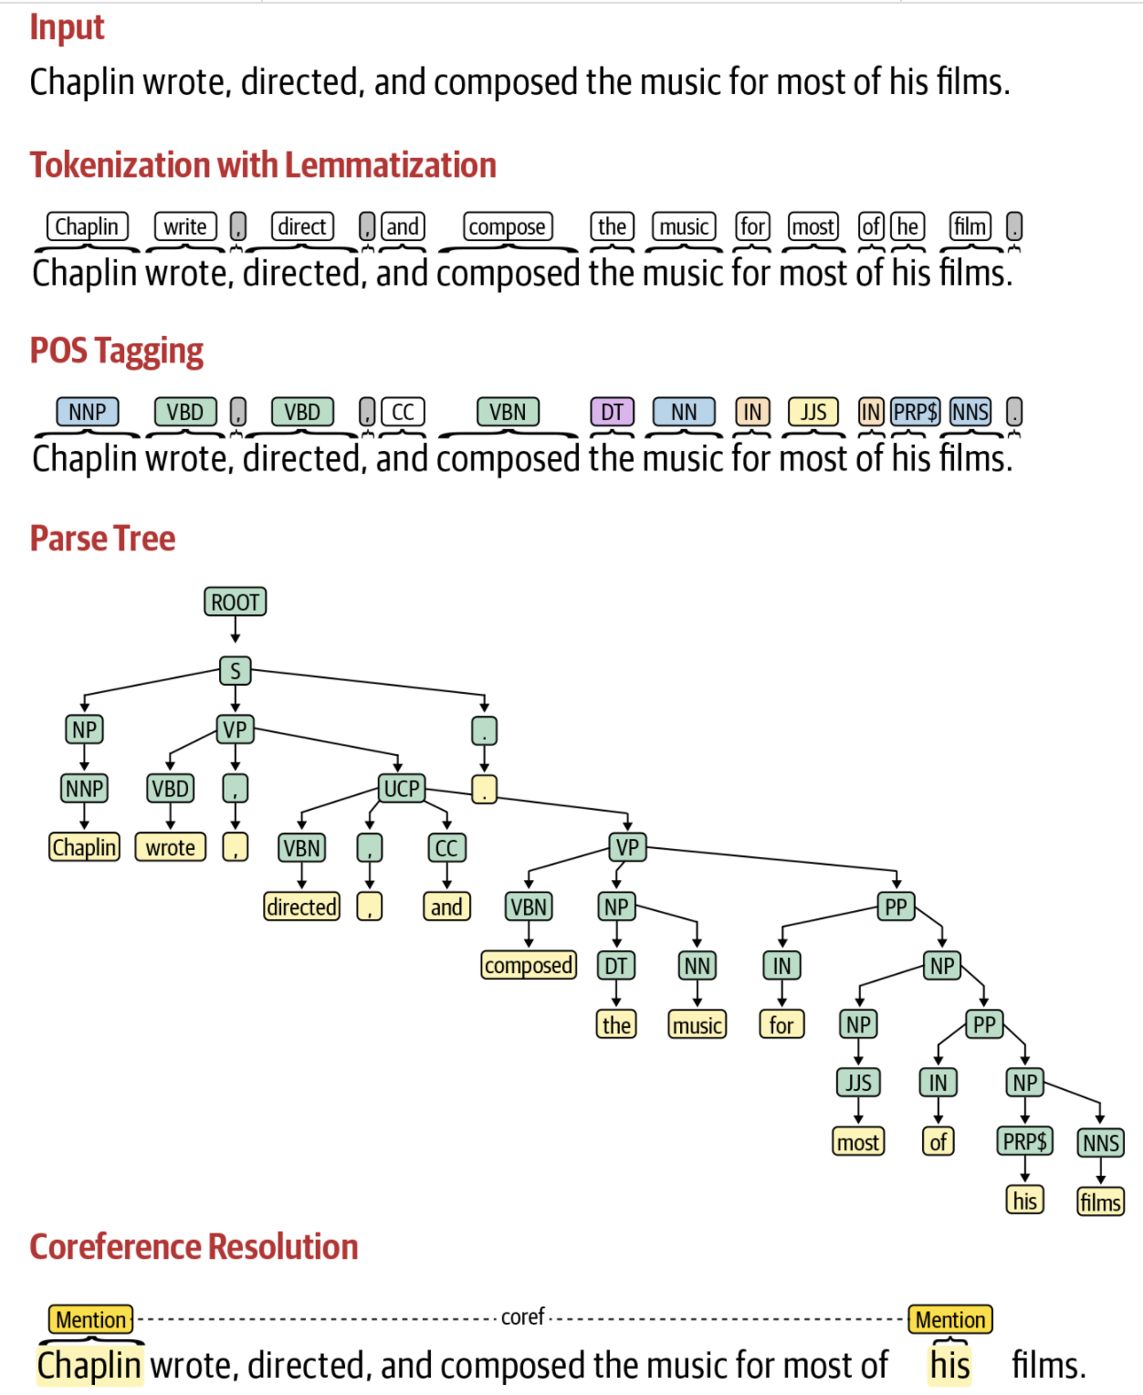
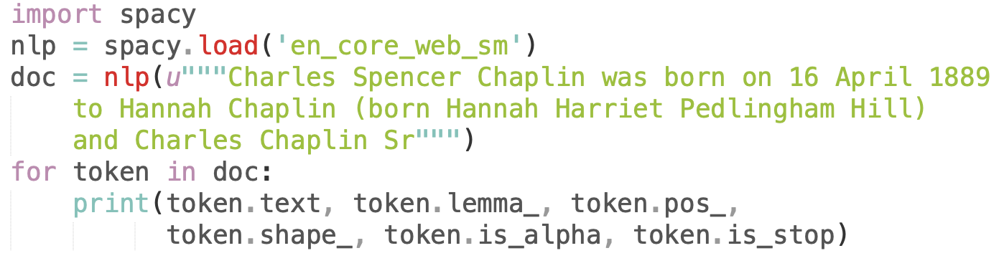
Advanced pre-processing
To use spacy, first install them in your conda / miniconda / virtual environment
pip3 install spacy
python3 -m spacy download en_core_web_sm

Slide 39
NLP Pipeline
Feature Engineering

Slide 40
Feature Engineering - Motivation
Feature Engineering - Process of set of methods that will accomplish the task of feature extraction (converting text into numeric vectors)
Feature Engineering is dealt in the future lecture in detail.
Two major categories are defined here.
1. Classical NLP / ML Pipeline
2. DL Pipeline

Slide 41
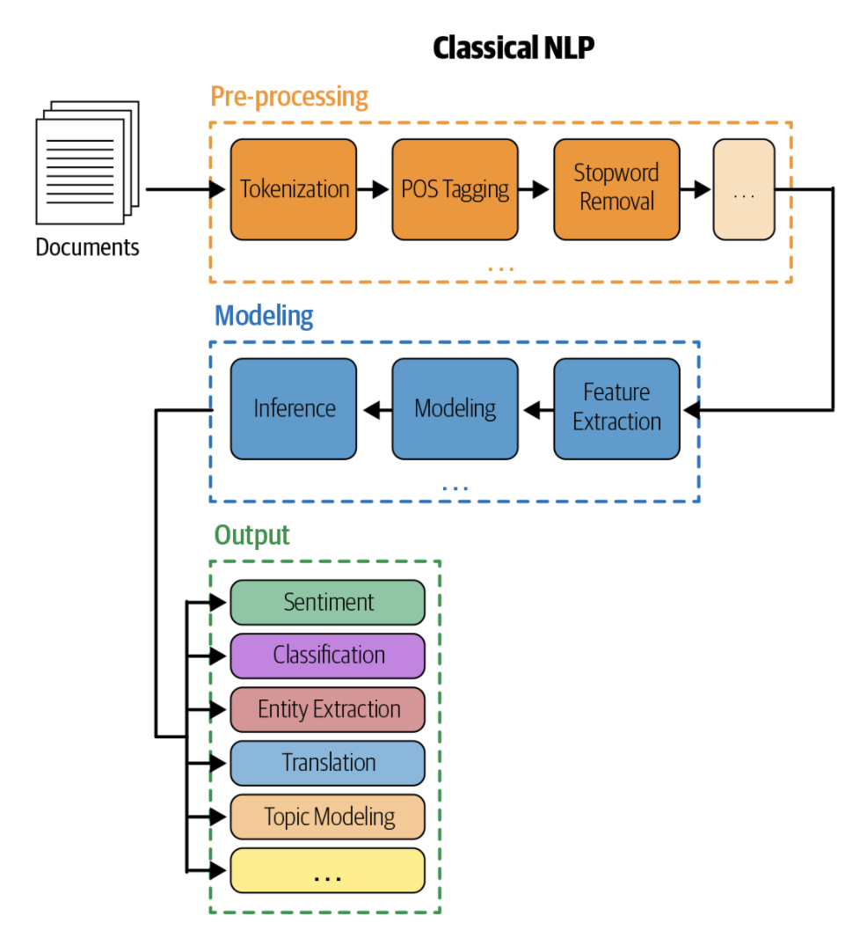
Feature Engineering - Classical NLP
Converts the raw data into a format that can be consumed by a machine.
In Classical ML, we have turned categorical variables into numbers and fed into the model.
In NLP, we need to convert the text into some form of numeric vectors and will feed it into the model
In Classical NLP, the feature extraction process is handcrafted and done by engineers who have domain expertise in the area of the problem in hand

Slide 42
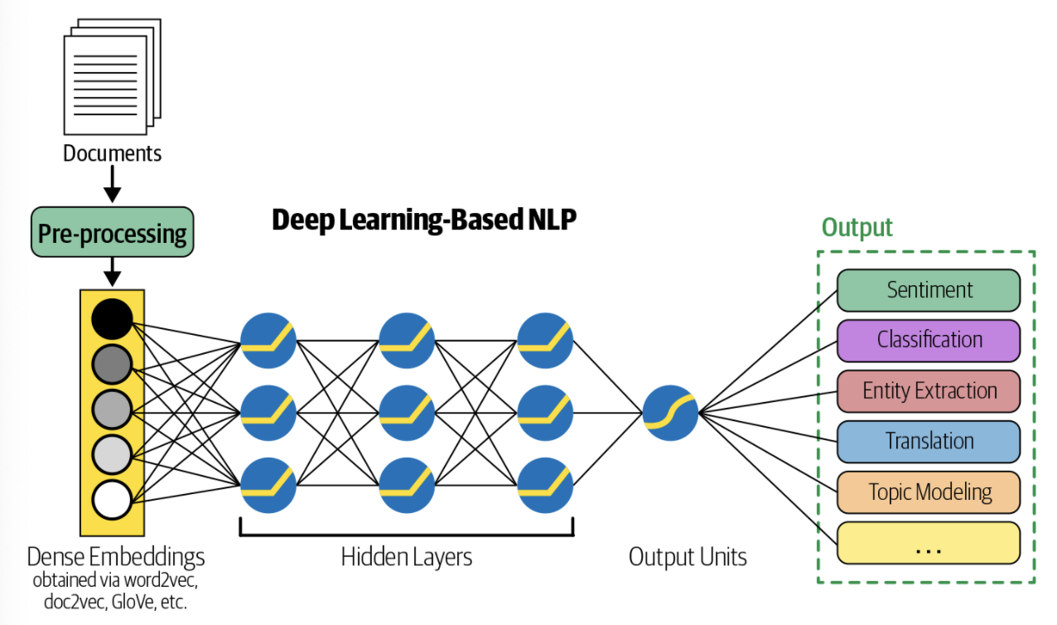
Feature Engineering - Deep NLP
Converts the raw data into a format that can be consumed by a machine.
In Deep Learning NLP, the model takes care of the feature extraction process
Raw data after pre-processing is sent to the model directly

Slide 43
NLP Pipeline
Modeling

Slide 44
Modeling - Motivation
Modeling - Process of building a model depending on the amount of data we have in hand
Simple Heuristics - Regular Expressions, Rule-based approaches
Create a feature from the heuristic for the ML model
Pre-process input to the ML model

Slide 45
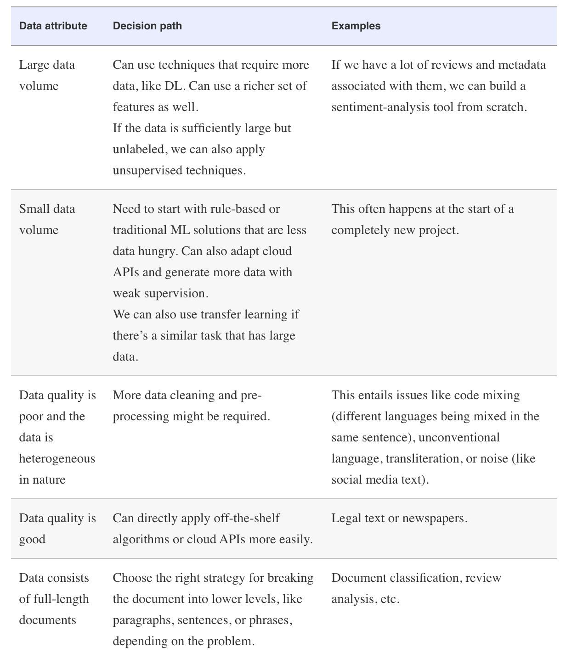
Modeling
Ensembles of Models
Feature Engineering
Transfer Learning

Slide 46
NLP Pipeline
Evaluation

Slide 47
Evaluation - Motivation
Evaluation – Measuring how good the model is
1) Use the right metric
2) Follow the right evaluation process
Intrinsic Evaluation
Extrinsic Evaluation

Slide 48
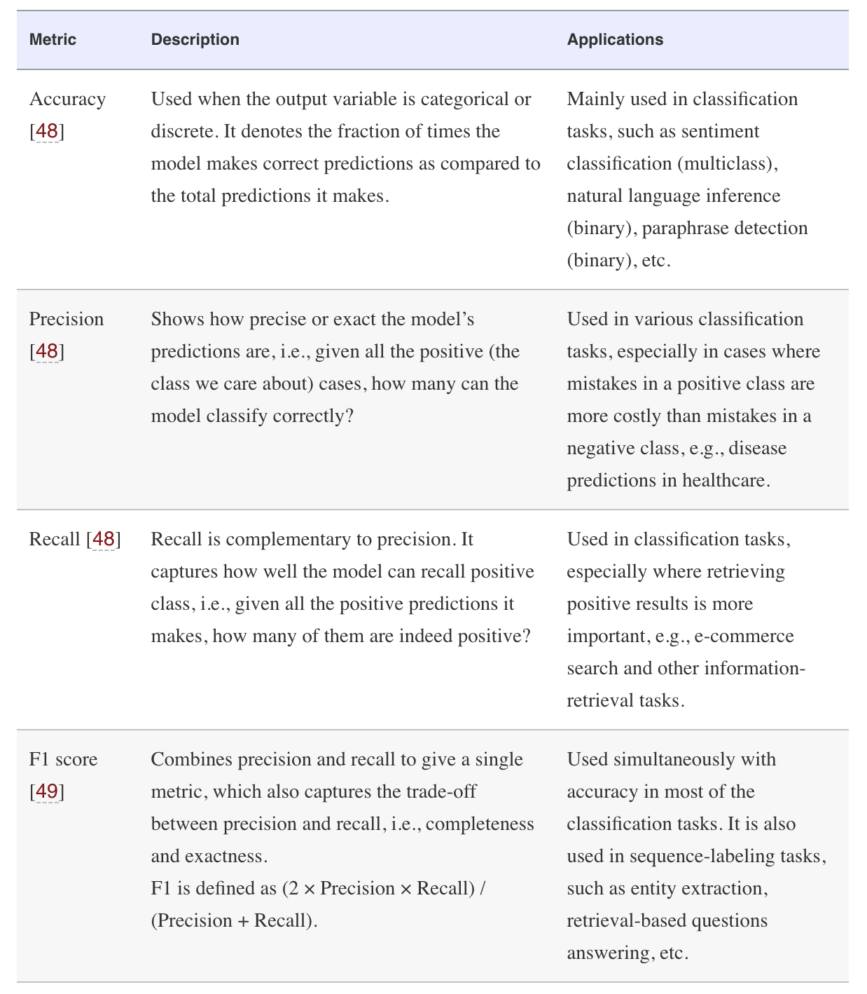
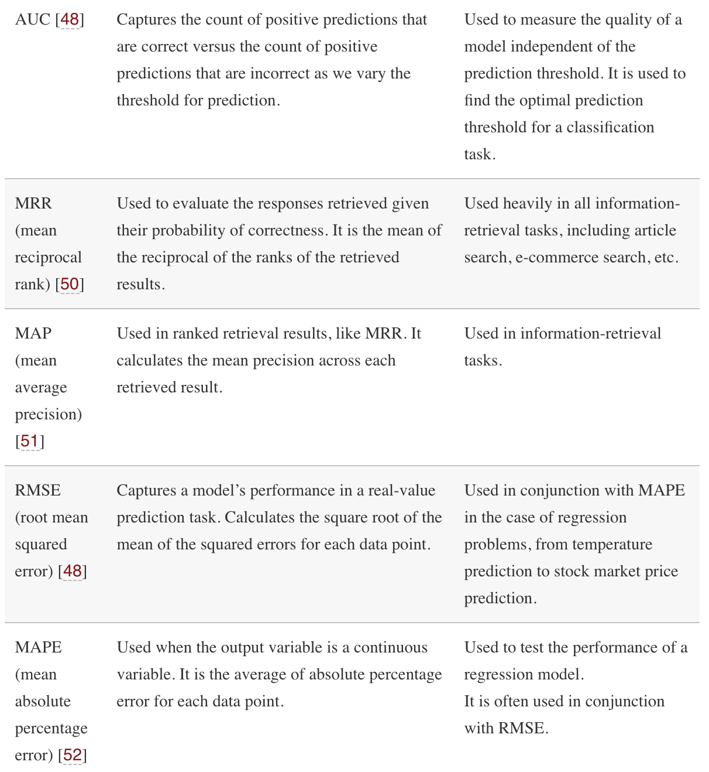
Intrinsic Evaluation

Slide 49
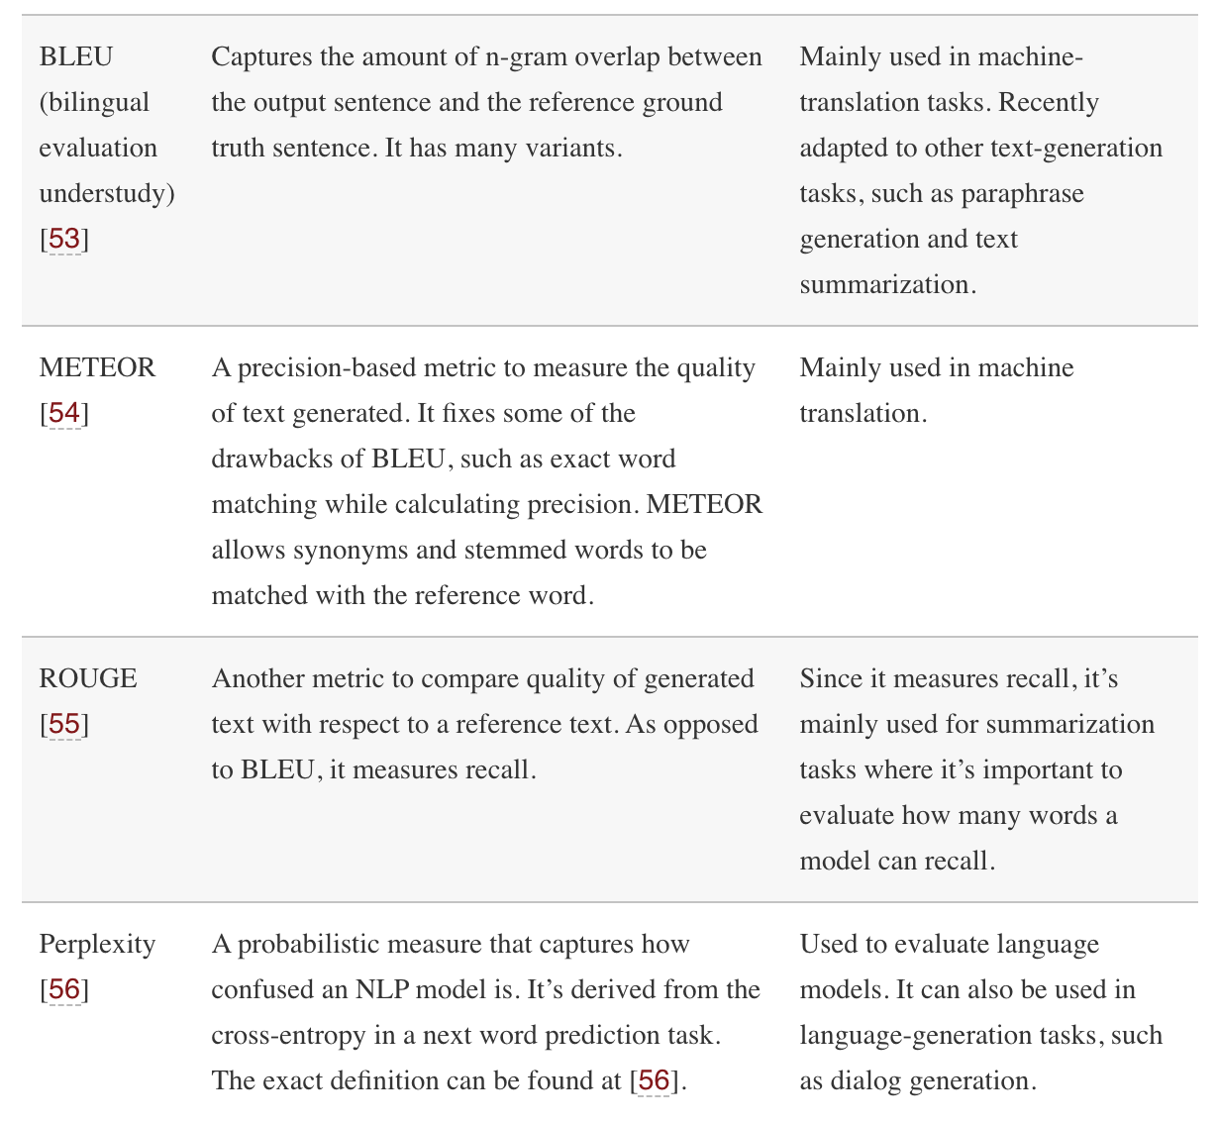
Intrinsic Evaluation

Slide 50
Extrinsic Evaluation
Involves the business metrics outside the AI/ML team
First, check to see if you achieve good intrinsic evaluation metrics
Then, go for extrinsic evaluation

Slide 51
NLP Pipeline
Deployment

Slide 52
Deployment
NLP model is deployed as a web service*
Some Cloud providers
Google Cloud Platform (GCP)
Amazon Web Services (AWS)
Microsoft Azure
* Will be seen in detail in Full Stack Data Science Systems course
Notes:
Talk about a real scenario in conversationHealth Inc

Slide 53
NLP Pipeline
Monitoring & Model Improvement

Slide 54
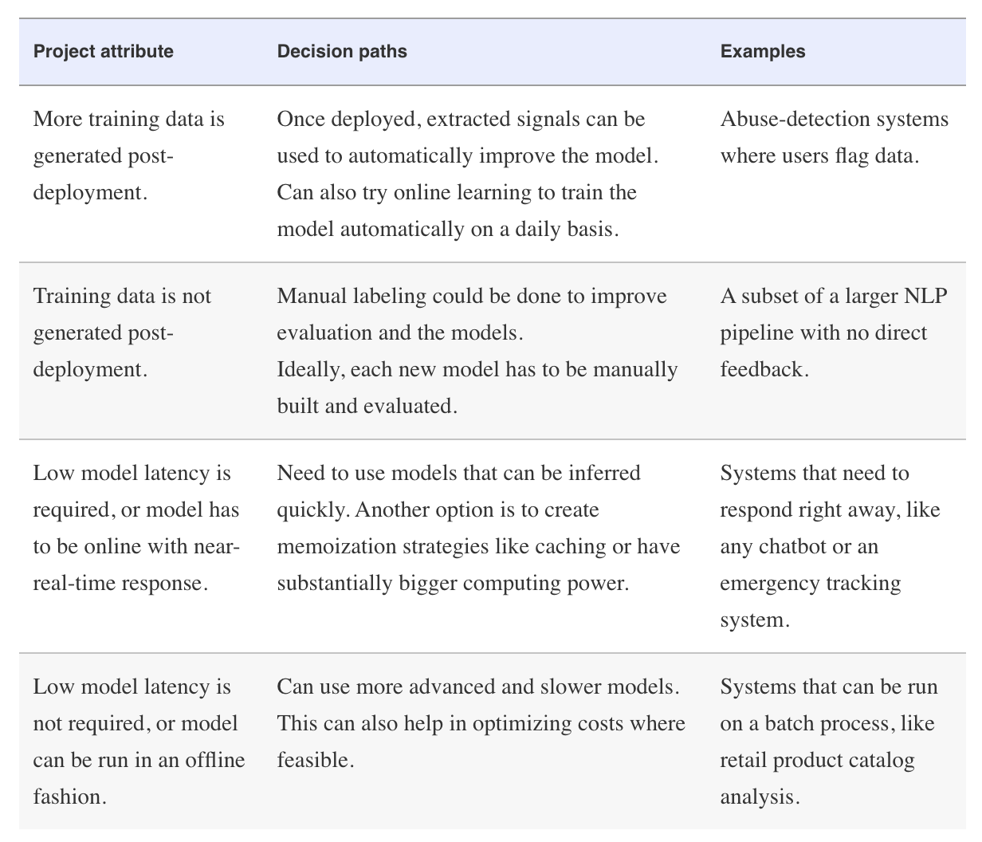
Monitoring & Model Updation
Monitoring must be done on a constant real-time basis
Performance dashboards to be included in the project
Notes:
Talk about a real scenario in conversationHealth Inc

Slide 55
Further Reading
Practical Natural Language Processing
Soumya Vajjala, Anuj Gupta, Harshit Surana, Bodhisattwa Majumder

